Slide 1
React js
Introduction to React JS

Slide 2
What is React Js?
React is a free and open-source front-end JavaScript library for building user interfaces based on UI components. It is maintained by Facebook.

Slide 3
Why React js?

Slide 4
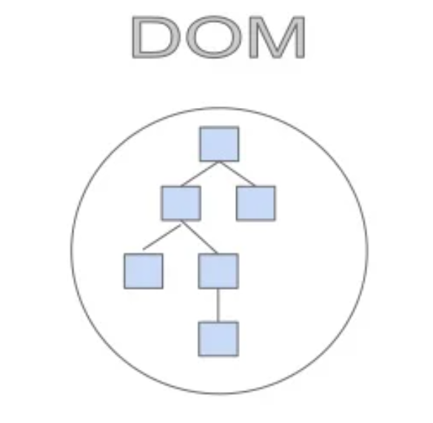
DOM Vs Virtual DOM

Slide 5
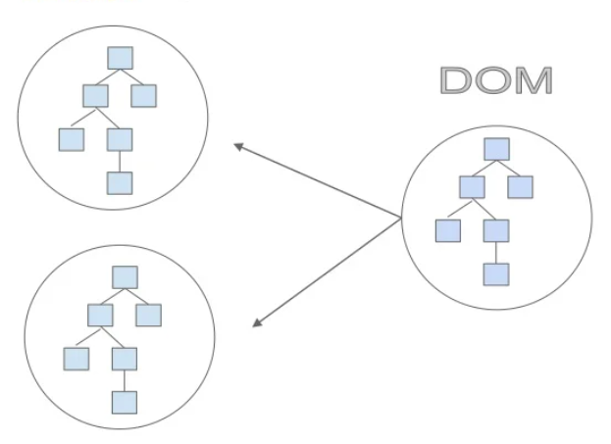
Virtual DOM

Slide 6
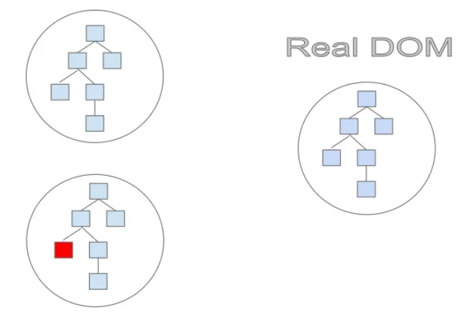

Slide 7
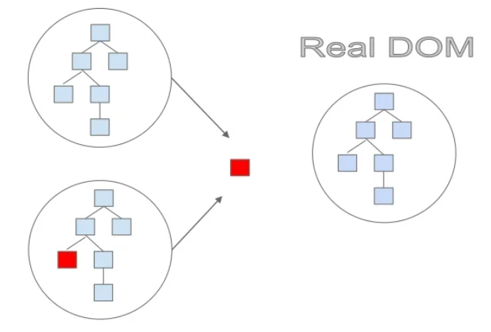

Slide 8
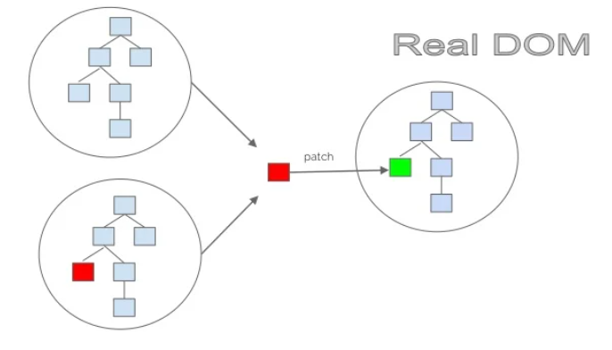

Slide 9
Who updates virtual dom?

Slide 10
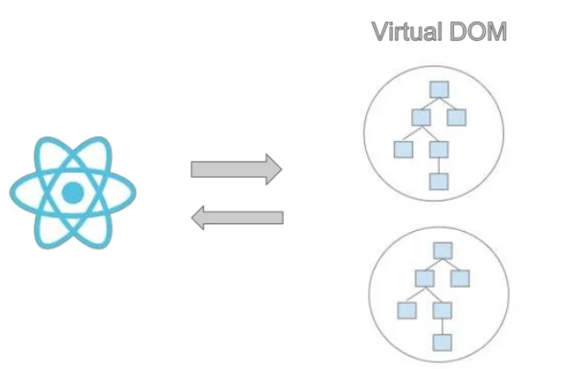

Slide 11
What is JSX?

Slide 12
State Vs Props

Slide 13
React hooks
useEffect
useLayoutEffect
useState
useReducer
useRef
You can create your own hook

Slide 14
How to crack React js?
We can start with the documentation (Installation, Main concept and Hooks):
https://reactjs.org/docs/getting-started.html

Slide 15
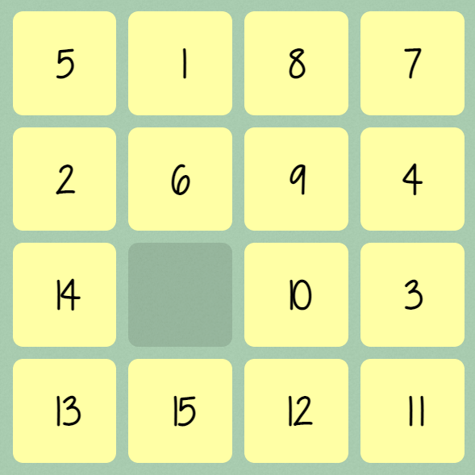
Task
Fifteen puzzle game with Reset and count moves features.
Code must contain all of this components :
Board
Cell
game

Slide 16
React has No End

